Slide 1


Ibrahim Kobeissy
14-Feb-2022

Slide 2

Outline
Executive Summary
Introduction
Methodology
Results
Conclusion
Appendix

Slide 3
Executive Summary
Summary of methodologies
Data collection and Scraping
Data wrangling
EDA using visualization and SQL
Building an interactive map with Folium
Building a Dashboard with Plotly Dash
Predictive analysis (Classification)
Summary of all results
Exploratory data analysis results
Interactive analytics demo in screenshots
Predictive analysis results

Slide 4
Introduction
Project background and context
We will predict if the Falcon 9 first stage will land successfully.
SpaceX advertises Falcon 9 rocket launches on its website with a cost of 62 million dollars; other providers cost upward of 165 million dollars each, much of the savings is because SpaceX can reuse the first stage.
Problems you want to find answers
The key factor that determines if the rocket will land successfully
Therefore if we can determine if the first stage will land, we can determine the cost of a launch.
This information can be used if an alternate company wants to bid against SpaceX for a rocket launch

Slide 5


Slide 6
Methodology
Executive Summary
Data collection methodology:
SpaceX Rest API
Web Scrapping from Wikipedia
Perform data wrangling
Data encoding and removing irrelevant data
Perform exploratory data analysis (EDA) using visualization and SQL
Perform interactive visual analytics using Folium and Plotly Dash
Perform predictive analysis using classification models
How to build, tune, evaluate classification models

Slide 7
Data Collection
SpaceX REST API launch data,
This would give us information about the launches, rockets, payload, specifications and landing outcome
Falcon 9 Launch data from Wikipedia is web scrapped using BeautifulSoup.
SpaceX Rest API
Json Data
Normalize the data into CSV
Get HTML from Wikipedia
Extract data
using beautiful
soup
Normalize the data into CSV

Slide 8
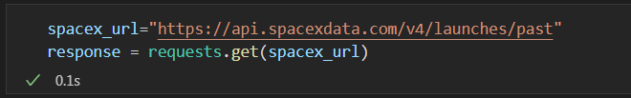
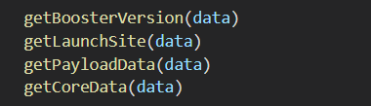
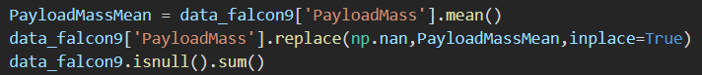
Data Collection – SpaceX API
Getting Response from API
Converting Response to a .json
Apply custom functions to clean data
Data cleanup
Filter and export to .csv
SpaceX API
Filter Falcon 9 Data only
Export to CSV
Data Wrangling
Github Notebook URL

Slide 9
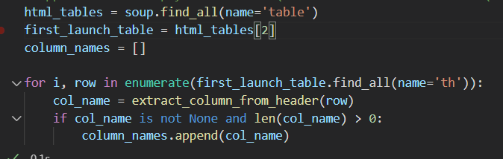
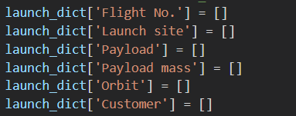
Data Collection - Scraping
Getting and parsing HTML
Filtering tables and columns
Dictionary creation
Export to CSV
Get HTML from Wikipedia
Export to CSV
Parse data
Extract data (beautiful soup)
Github Notebook URL

Slide 10
Data Wrangling
In the data set, there are several different cases where the booster did not land successfully.
Sometimes a landing was attempted but failed due to an accident; for example, “True Ocean” means the mission outcome was successfully landed to a specific region of the ocean while “False Ocean” means the mission outcome was unsuccessfully landed to a specific region of the Ocean.
We mainly convert those outcomes into Training Labels with 1 means the booster successfully landed 0 means it was unsuccessful.
Perform Exploratory Data Analysis EDA on dataset
Calculate the number of launches at each site
Calculate the number and occurrence of each orbit
Export dataset as
.CSV
Calculate the number and occurrence of mission outcome per orbit type
Create a landing outcome label from Outcome column
Github Notebook URL

Slide 11
EDA with Data Visualization
Scatter Chart
Flight Number VS. Payload Mass
Flight Number VS. Launch Site
Payload VS. Launch Site
Orbit VS. Flight Number
Payload VS. Orbit Type
Orbit VS. Payload Mass
Bar Chart
Success Rate of each orbit type
Line Chart
Launch success Yearly trend
Github Notebook URL

Slide 12
EDA with SQL
Display the names of the unique launch sites in the space mission
Display 5 records where launch sites begin with the string 'CCA’
Display the total payload mass carried by boosters launched by NASA (CRS)
Display average payload mass carried by booster version F9 v1.1
List the date when the first successful landing outcome in ground pad was acheived.
List the names of the boosters which have success in drone ship and have payload mass greater than 4000 but less than 6000
List the total number of successful and failure mission outcomes
List the names of the booster_versions which have carried the maximum payload mass. Use a subquery
List the failed landing_outcomes in drone ship, their booster versions, and launch site names for in year 2015
Rank the count of landing outcomes (such as Failure (drone ship) or Success (ground pad)) between the date 2010-06-04 and 2017-03-20, in descending order
Github Notebook URL

Slide 13
Build an Interactive Map with Folium
Summarize what map objects such as markers, circles, lines, etc. you created and added to a folium map
On the Folium map we added the following object
Map Marker, to create a marker on the map
Icon Marker, to add an icon on the map
Circle Marker, to add a highlighted circle area with a text label on a specific coordinate
Polyline, to create a line between points
Marker Cluster Object, to visualize multiple marker having the same coordinates
Github Notebook URL

Slide 14
Build a Dashboard with Plotly Dash
Pie Chart showing the total launches by a certain site/all sites
Scatter Chart Scatter Graph showing the relationship with Outcome and Payload Mass (Kg) for the different Booster Versions
Github Notebook URL

Slide 15
Predictive Analysis (Classification)
BUILDING MODEL
Load our dataset into NumPy and Pandas
Transform Data
Split our data into training and test data sets
Check how many test samples we have
Decide which type of machine learning algorithms we want to use
Set our parameters and algorithms to GridSearchCV
Fit our datasets into the GridSearchCV objects and train our dataset.
EVALUATING MODEL
Check accuracy for each model
Get tuned hyperparameters for each type of algorithms
Plot Confusion Matrix
IMPROVING MODEL
Feature Engineering
Algorithm Tuning
FINDING THE BEST PERFORMING CLASSIFICATION MODEL
The model with the best accuracy score wins the best performing model
In the notebook there is a dictionary of algorithms with scores at the bottom of the notebook.
Github Notebook URL

Slide 16
Results
Exploratory data analysis results
Interactive analytics demo in screenshots
Predictive analysis results

Slide 17


Slide 18
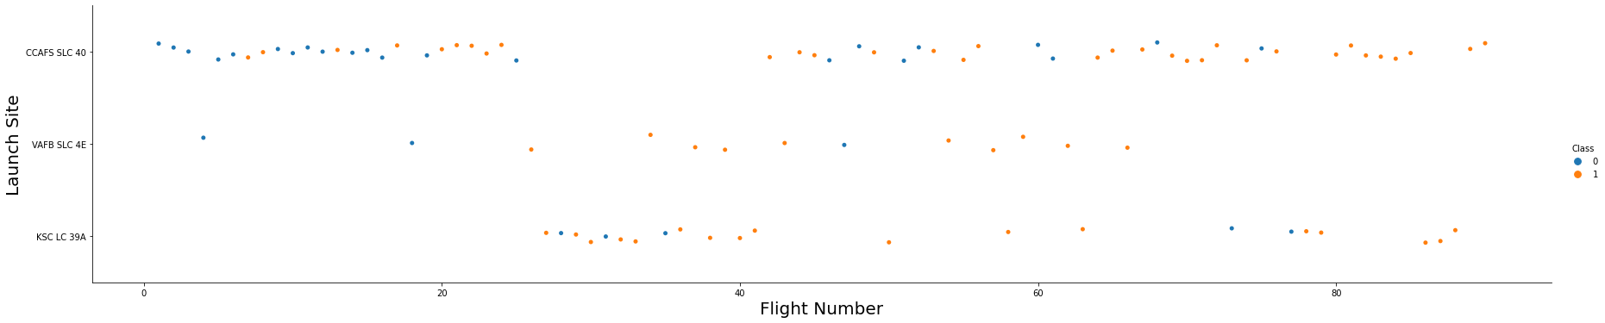
Flight Number vs. Launch Site
The more amount of flights at a launch site the greater the success rate at a launch site.

Slide 19
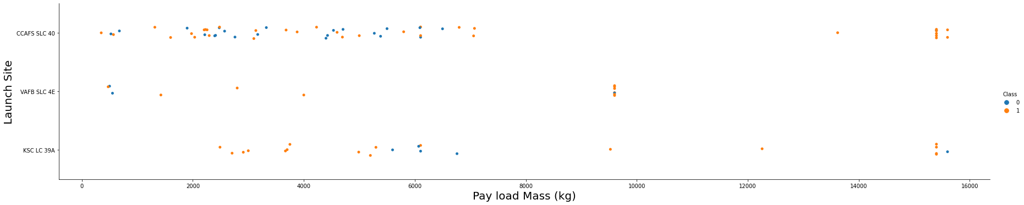
Payload vs. Launch Site
The greater the payload mass for Launch Site CCAFS SLC 40 the higher the success rate for the Rocket.
There is not quite a clear pattern to be found using this visualization to make a decision if the Launch Site is dependant on Pay Load Mass for a success launch.

Slide 20
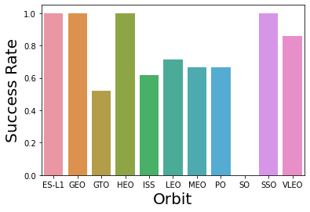
Success Rate vs. Orbit Type
Orbit GEO,HEO,SSO,ES-L1 has the best Success Rate

Slide 21
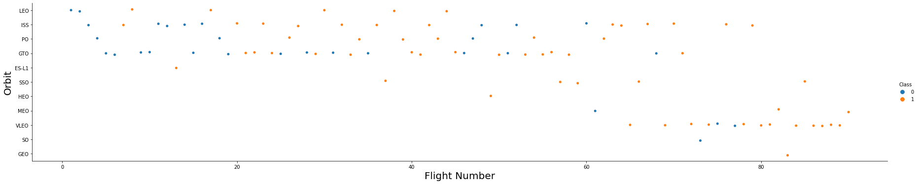
Flight Number vs. Orbit Type
You should see that in the LEO orbit the Success appears related to the number of flights; on the other hand, there seems to be no relationship between flight number when in GTO orbit.

Slide 22
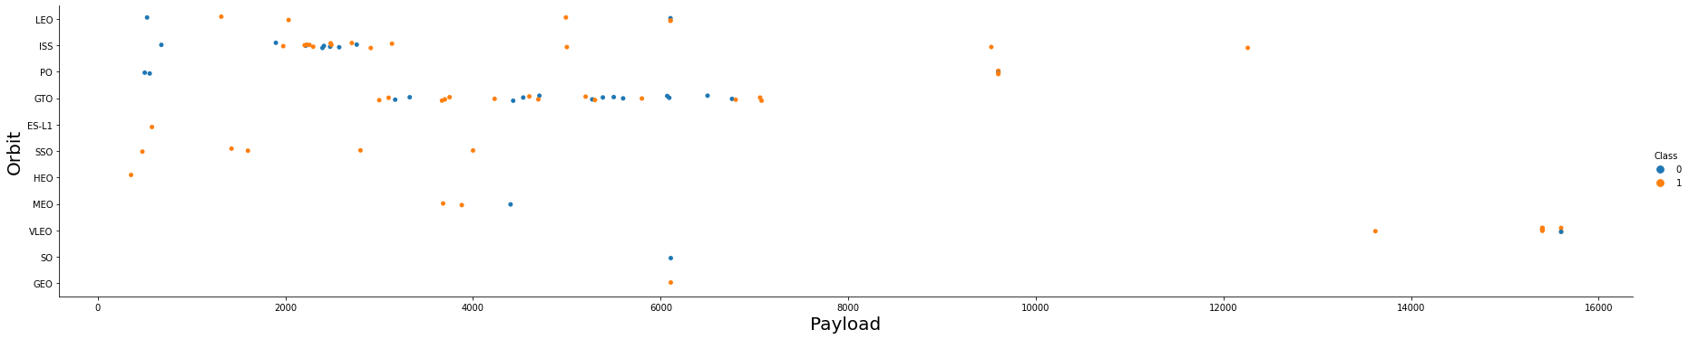
Payload vs. Orbit Type
You should observe that Heavy payloads have a negative influence on GTO orbits and positive on GTO and Polar LEO (ISS) orbits.

Slide 23
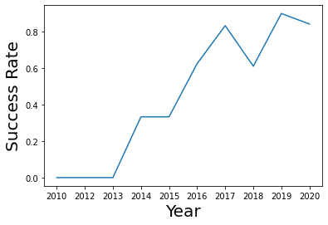
Launch Success Yearly Trend
You can observe that the success rate since 2013 kept increasing till 2020

Slide 24
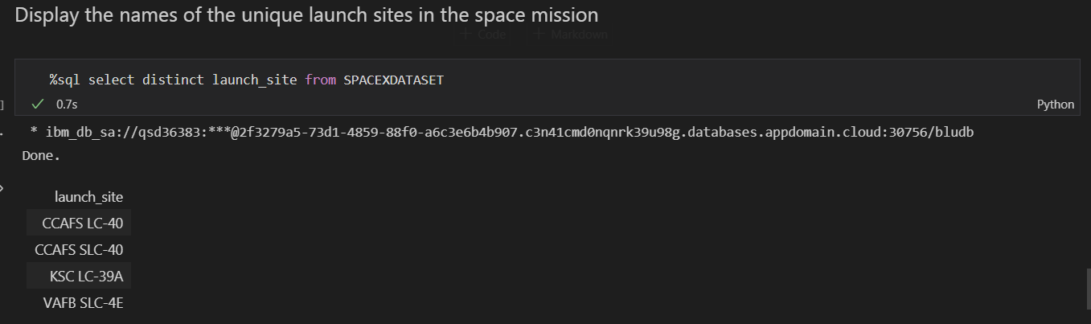
All Launch Site Names

Slide 25
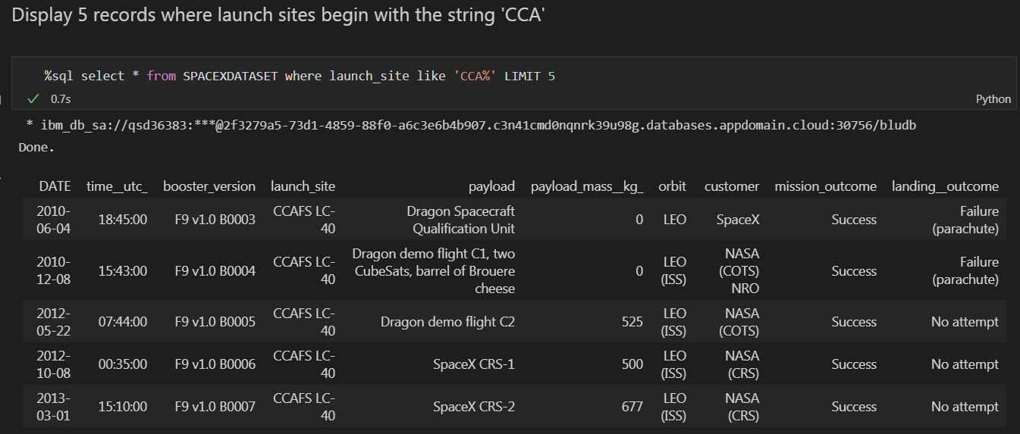
Launch Site Names Begin with 'CCA'

Slide 26
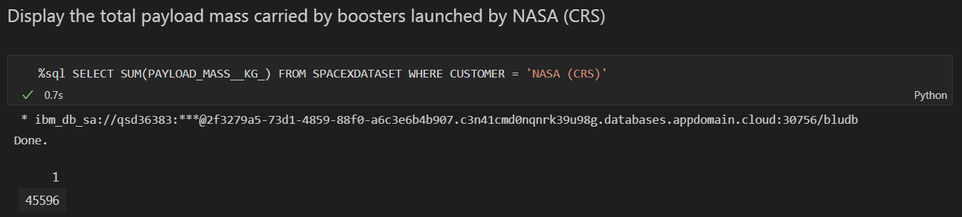
Total Payload Mass

Slide 27
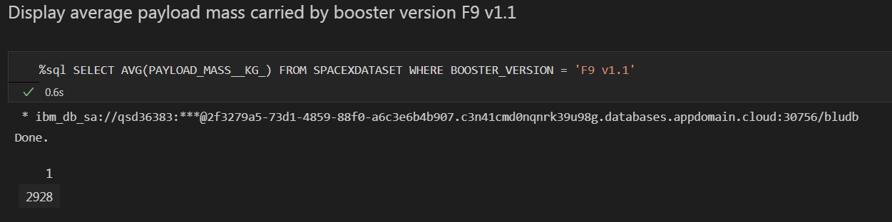
Average Payload Mass by F9 v1.1

Slide 28
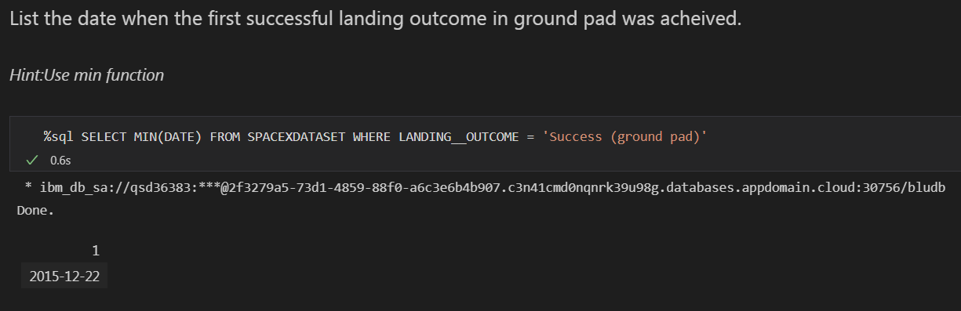
First Successful Ground Landing Date

Slide 29
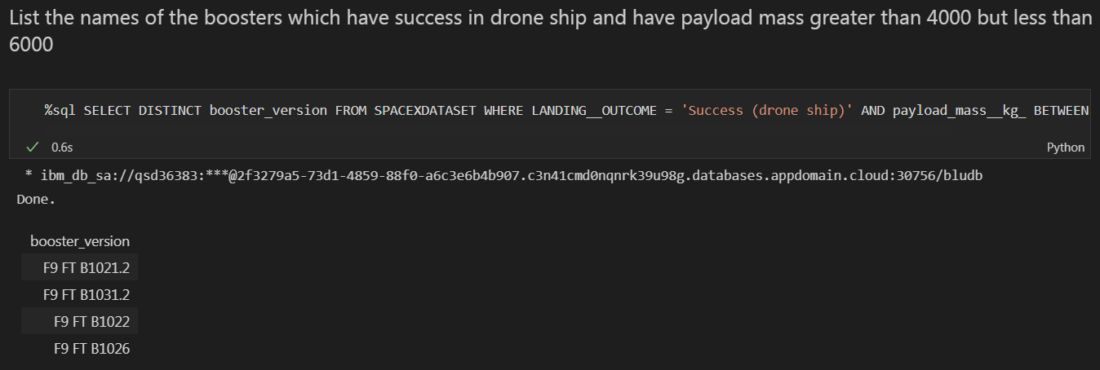
Successful Drone Ship Landing with Payload between 4000 and 6000

Slide 30
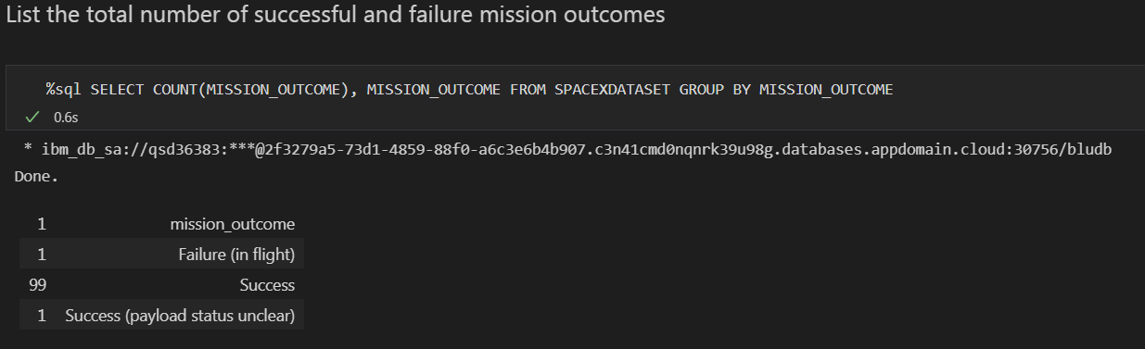
Total Number of Successful and Failure Mission Outcomes

Slide 31
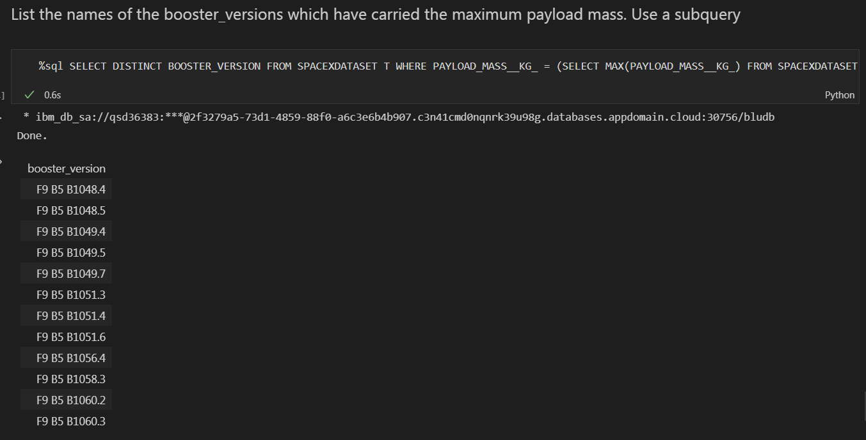
Boosters Carried Maximum Payload

Slide 32
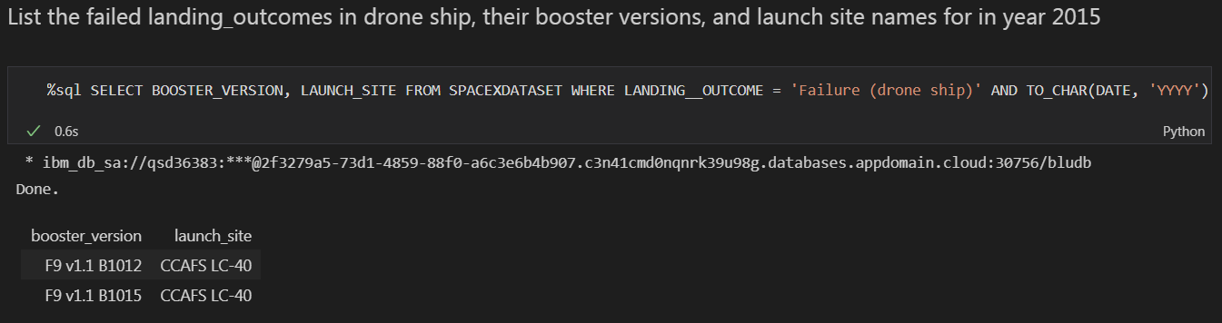
2015 Launch Records

Slide 33
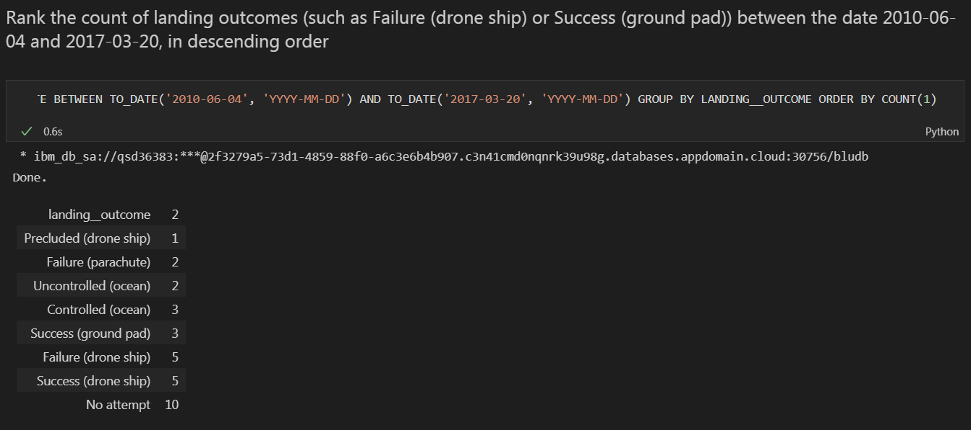
Rank Landing Outcomes Between 2010-06-04 and 2017-03-20

Slide 34


Slide 35
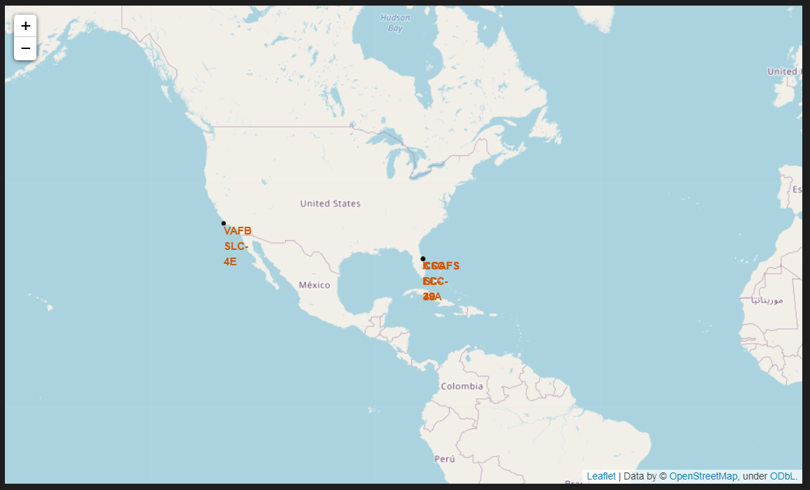
All launch sites

Slide 36
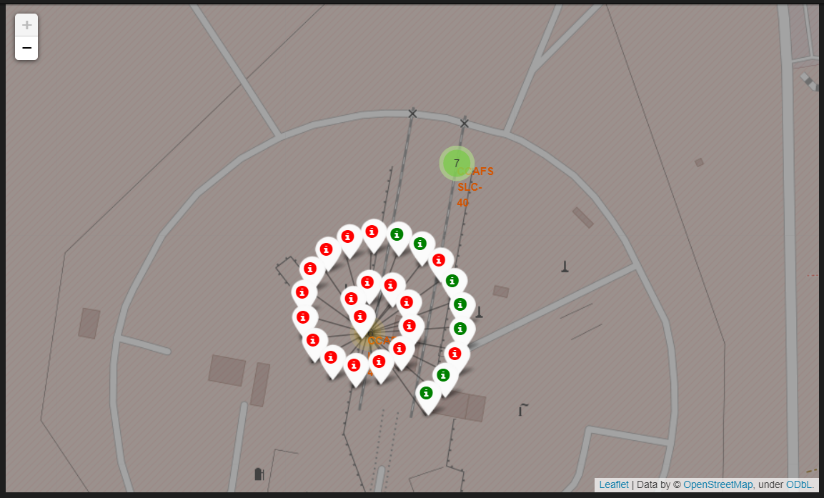
Colour Labelled Markers

Slide 37
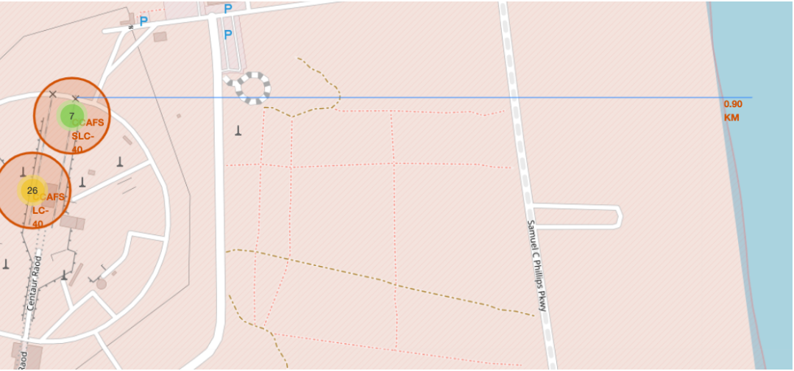
Working out Launch Sites distance to landmarks

Slide 38


Slide 39

Total Success Launch By Site

Slide 40
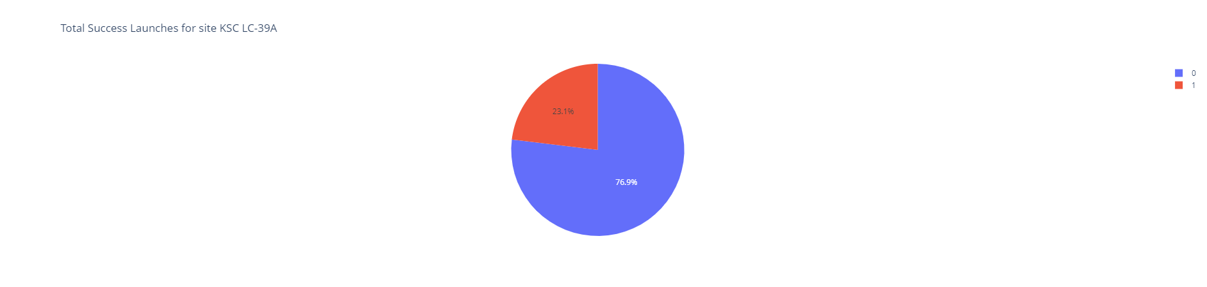
Highest launch success ratio

Slide 41
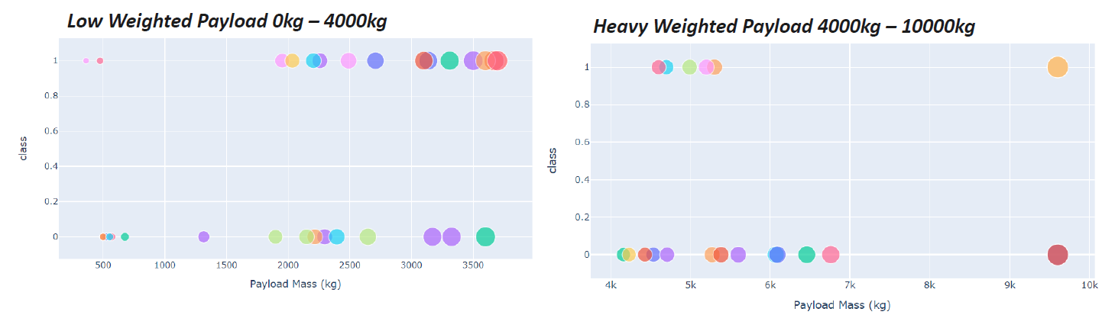
Payload vs. Launch Outcome

Slide 42


Slide 43
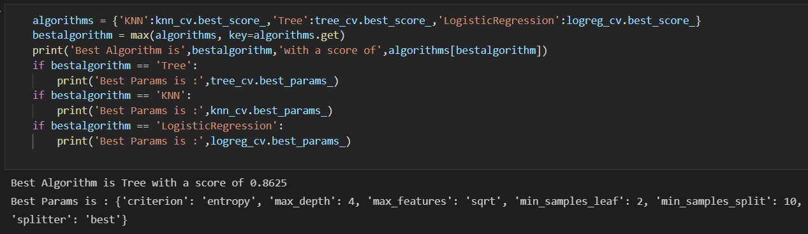
Classification Accuracy

Slide 44
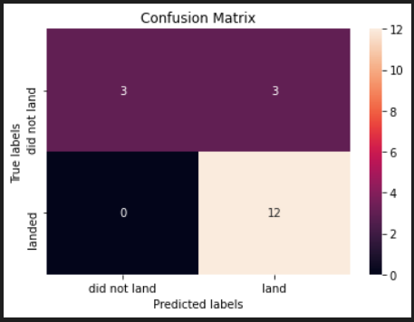
Confusion Matrix
Confusion matrix for the Tree

Slide 45
Conclusions
The Tree Classifier Algorithm is the best for Machine Learning for this dataset
Low weighted payloads perform better than the heavier payloads
The success rates for SpaceX launches is directly proportional time in years they will eventually perfect the launches
We can see that KSC LC-39A had the most successful launches from all the sites
Orbit GEO,HEO,SSO,ES-L1 has the best Success Rate

Slide 46
Appendix

Slide 47


